Slide 1

DEPARTMENT OF COMPUTER SCIENCE AND ENGINEERING
Mini Project
On
CHUTES AND CLIMBS
Presentation By
BATCH C10
K PALLAVI SEN(21-5F6)
D. PRANITHA GOUD(21-5E8)
D. SHREHITHA(21-5E5)
GUIDE:
Mrs. P. RUPA

Slide 2
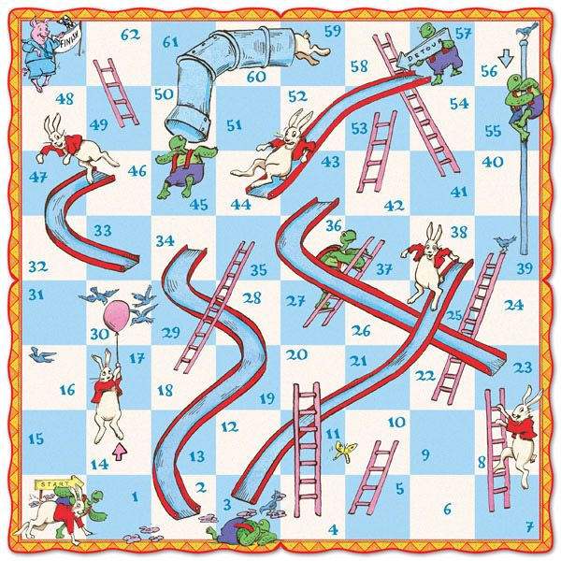
Table Of Contents :
Abstract
Introduction
Existing System
Proposed System
System Requirements
System Architecture
Methodology
UML Diagrams
Implementation
Results
Conclusion
Future Scope
References
Notes:
2

Slide 3
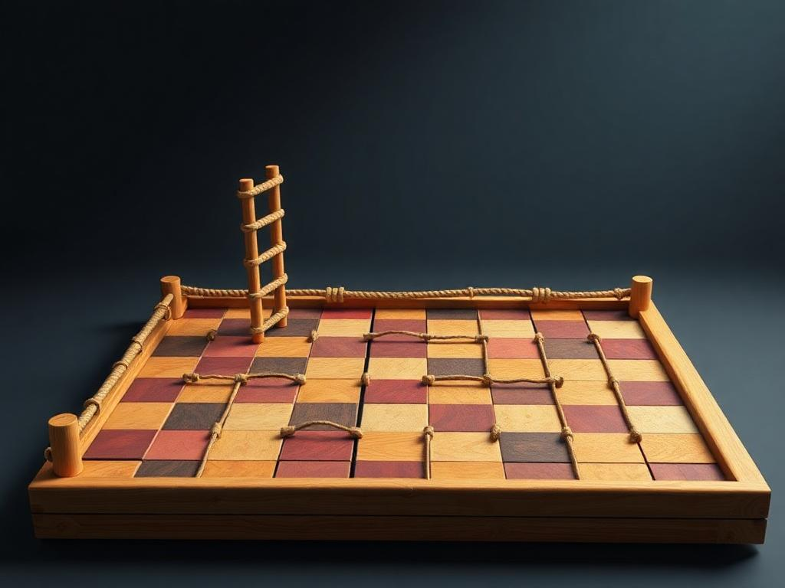
Abstract
Chutes and Climbs is a Board Game inspired by the Classic Game of Snake & Ladders. The objective of the project is to make the much more interesting by introducing the GUI. This game is designed in a way that which attracts any age of People. It is not only entertaining but also serves as an Educational Tool. Overall, Chutes and Climbs reimagines the Traditional Board Game with a Digital Interface.
Notes:
3

Slide 4
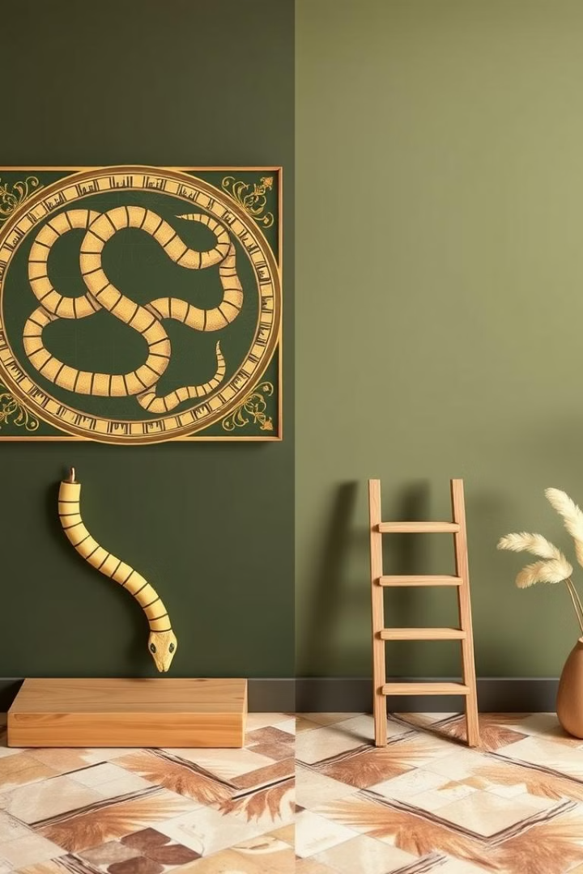

Introduction
Snake and Ladder's rich history dates back to ancient India and also we know there are many digital versions of it.
In this, Chutes and Climbs, we are changing the snakes to the chutes i.e., slides
It would be a very engaging game to any age of people and can be accessed anytime.
It is a game of killing the boredom of the person, where it need not to be wait for others.
It helps the people to adopt the skill of analyzing and builds the curiosity.
Notes:
4

Slide 5
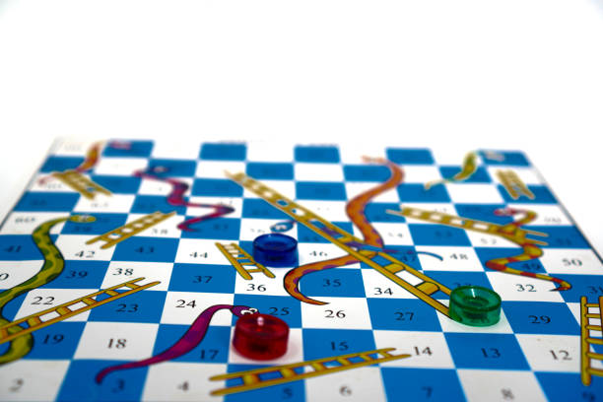
Existing System
Physical Limitations :Traditional board games require physical presence and manual game progression.
Limited Interactivity : Classic versions lack dynamic elements and real-time feedback.
Accessibility Issues : Physical games can be challenging for certain users or in remote settings.
Notes:
5

Slide 6
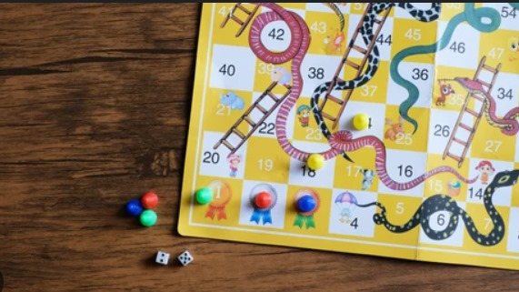
DisAdvantages of Existing System :
Lack of Skill Development
Limited Interaction
Time-Consuming
Short gameplay
Lack of social interaction

Slide 7
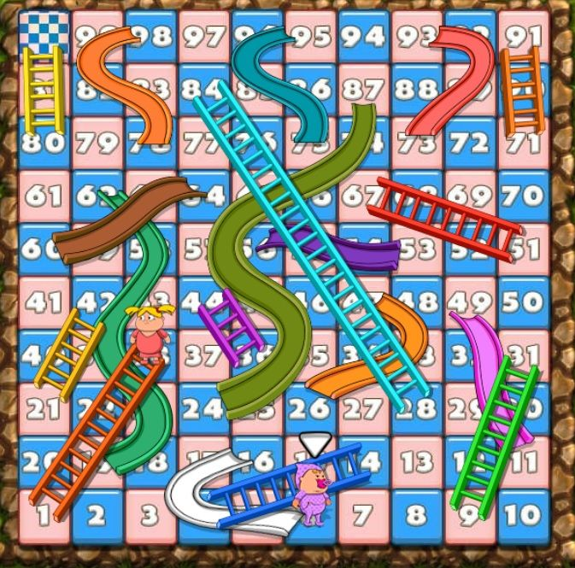
Proposed System
Welcome Page
Implementing Themes
Chutes (i. e., Slides)
Player Turn Indicator
Advantages – Scalability and Flexibility
Notes:
6

Slide 8
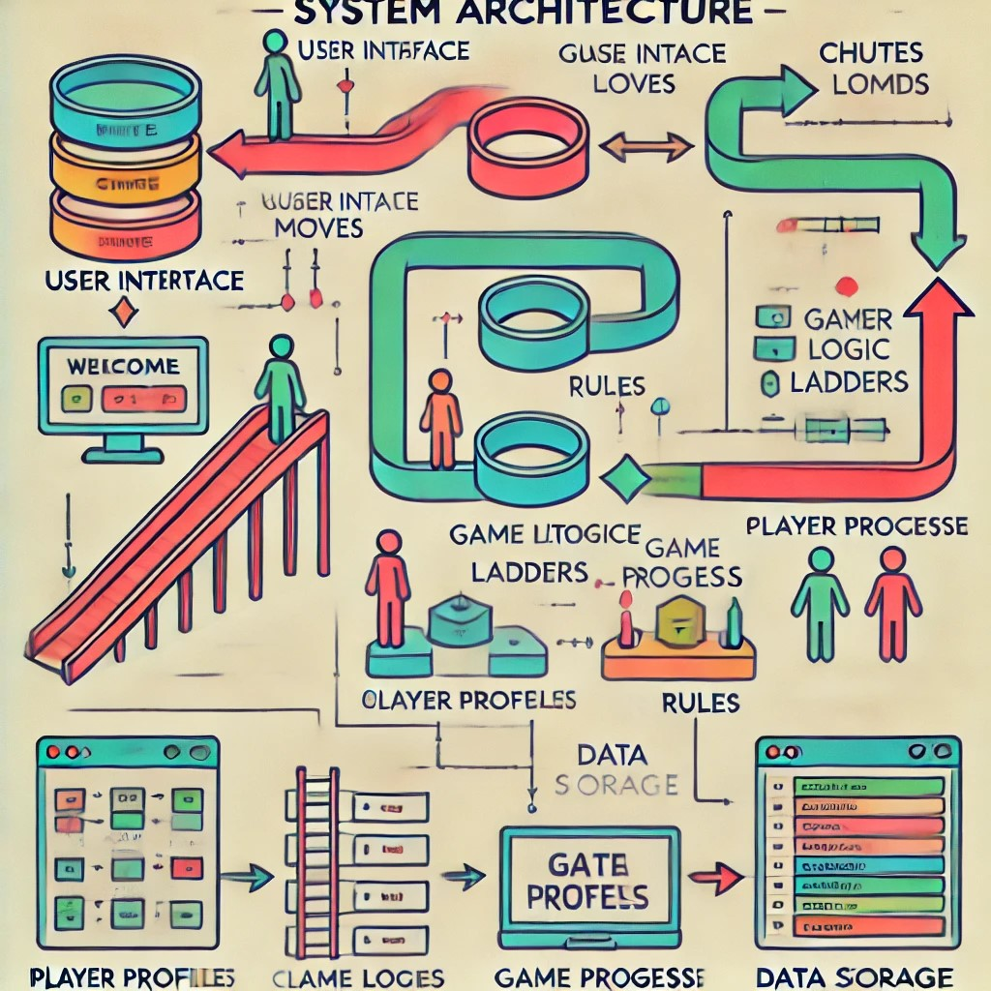
System Architecture :

Slide 9
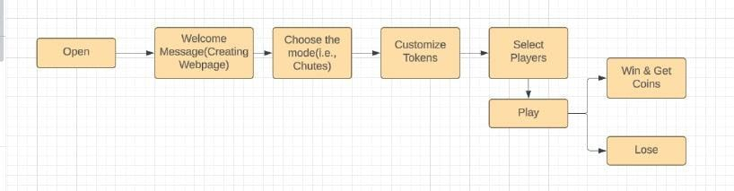



User Interface Layer
Game Logic Layer
Data Layer
Handles user inputs and displays game state using GUI components as a Frontend.
Manages rules, player turns, and movement calculations in the Backend.
Stores game state, player information, and board configuration.
Notes:
7

Slide 10
System Requirements :
Software Requirements:
Languages: HTML , CSS and JAVASCRIPT
Coding Tool: VS Code
Hardware Requirements:
Computer : Desktop or Laptop with 2GB of RAM.
Operating System : 32-bit or 64-bit versions of windows, macOS.
Display : Monitor with Resolution : 1024 * 768 pixels.

Slide 11
Methodology:
Planning & Requirements Gathering
Creating a Website of Chutes and Climbs
The Welcome Page, Board Size, Dice Mechanics, The chutes
Design Phase
The Python User Interface i.e.,Tkinter and the chutes (i.e., Snakes,Slides,Ropes)
The Random Function will be used for generating random numbers
Development
Programming: Code for dice rolls and Player Movement
UI Development: Design interactive Screens
Notes:
8

Slide 12
Testing
Unit Testing: Test dice mechanics and Player movement
Integration Testing: Ensure smooth interaction between mechanics and UI.
Gameplay Testing: Test for any bugs or rule inconsistencies
Bug Fixing: Resolve any issues that arise during testing
Deployment
Deploy the game to the Website
Notes:
9

Slide 13
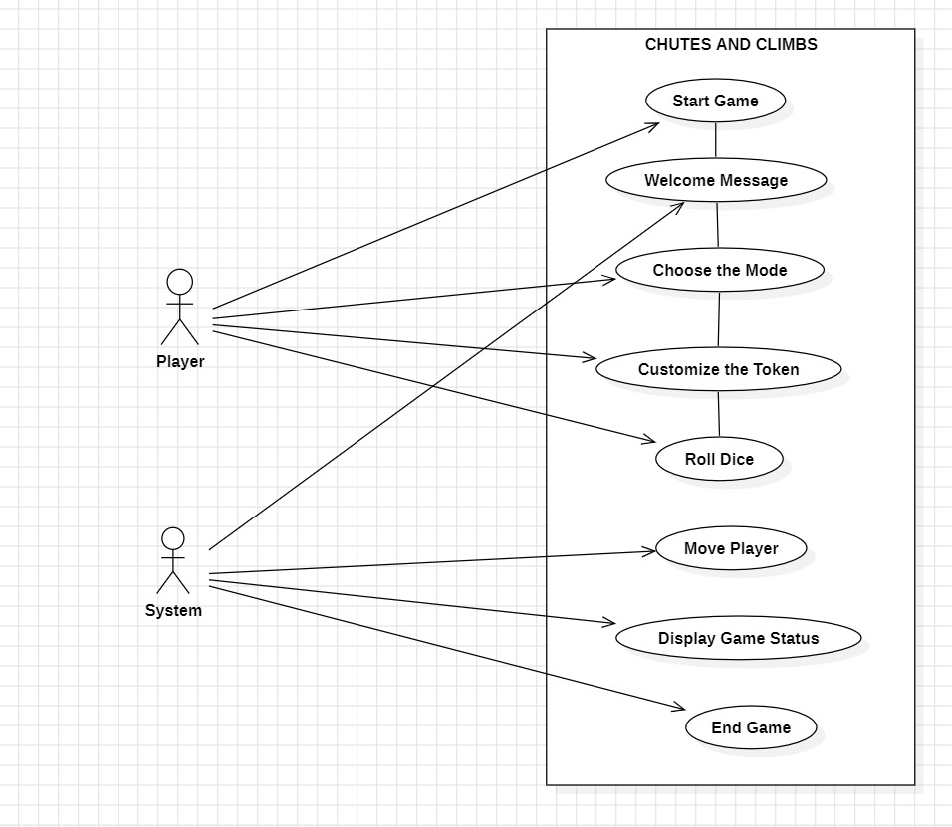
UML Diagrams::
Use Case Diagram:

Slide 14
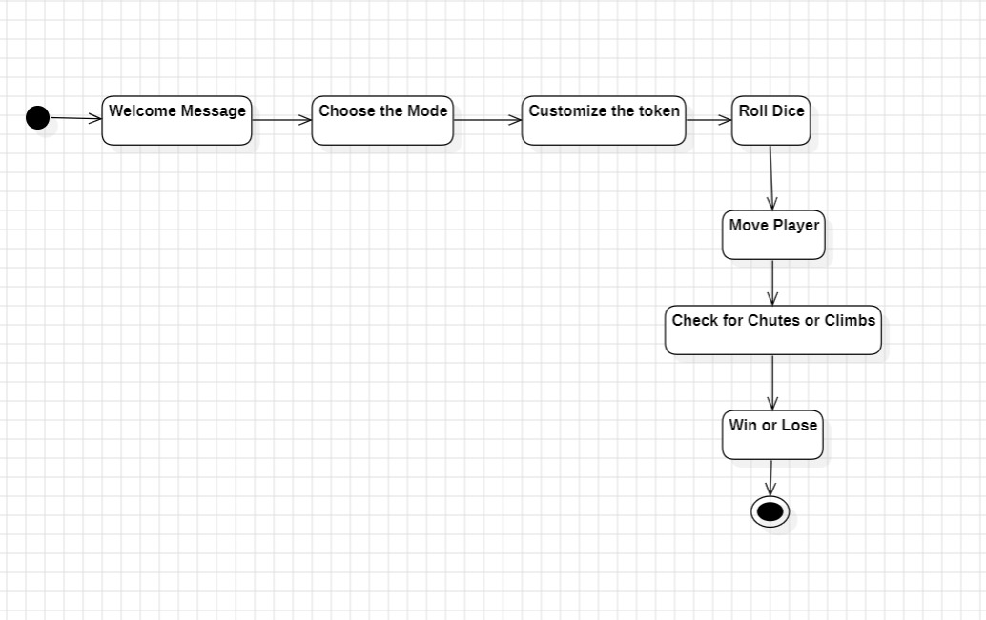
Activity Diagram

Slide 15
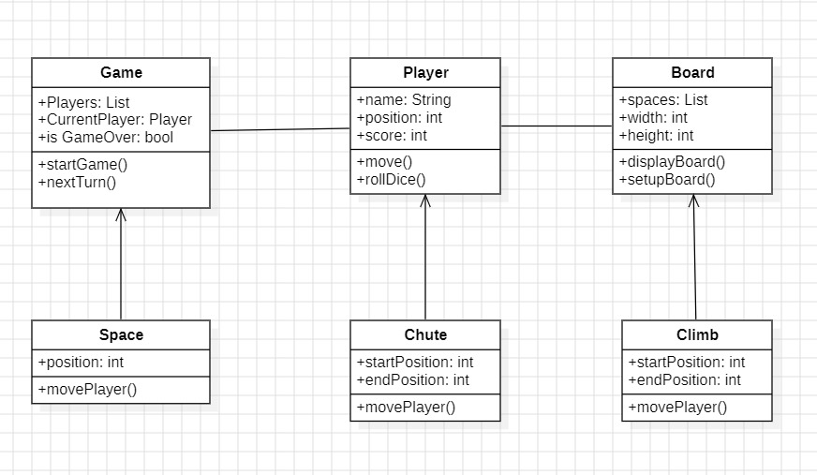
Class Diagram

Slide 16
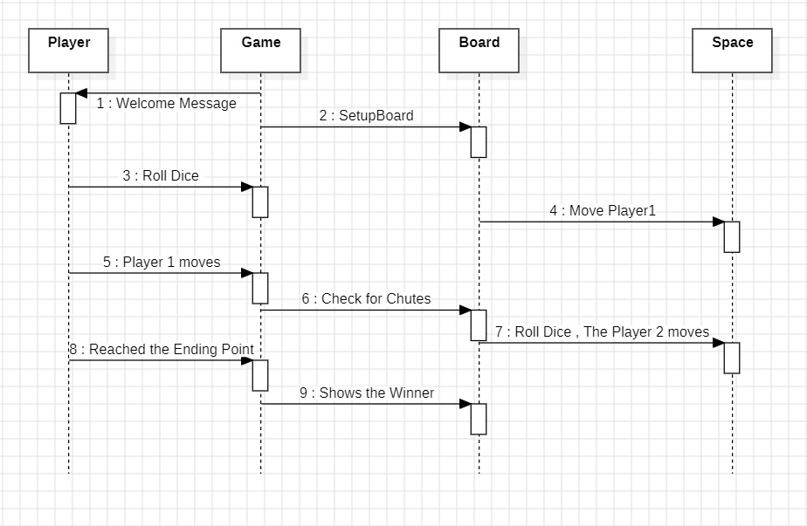
Sequence Diagram

Slide 17
Implementation :
Define the Welcome Page: By Using the HTML & CSS
Implement the Themes: 3 different Themes
Define the Game Board: Define the board with ladders and chutes as a dictionary.
Initialize Players and State: Setup players, their positions, and the winning square.
Roll Dice Function: Simulate a dice roll.
Move Player: Update the player’s position based on the dice roll, ladders and chutes.
Game Loop: Run the game until a player wins.
Main Function: Run the entire game.

Slide 18
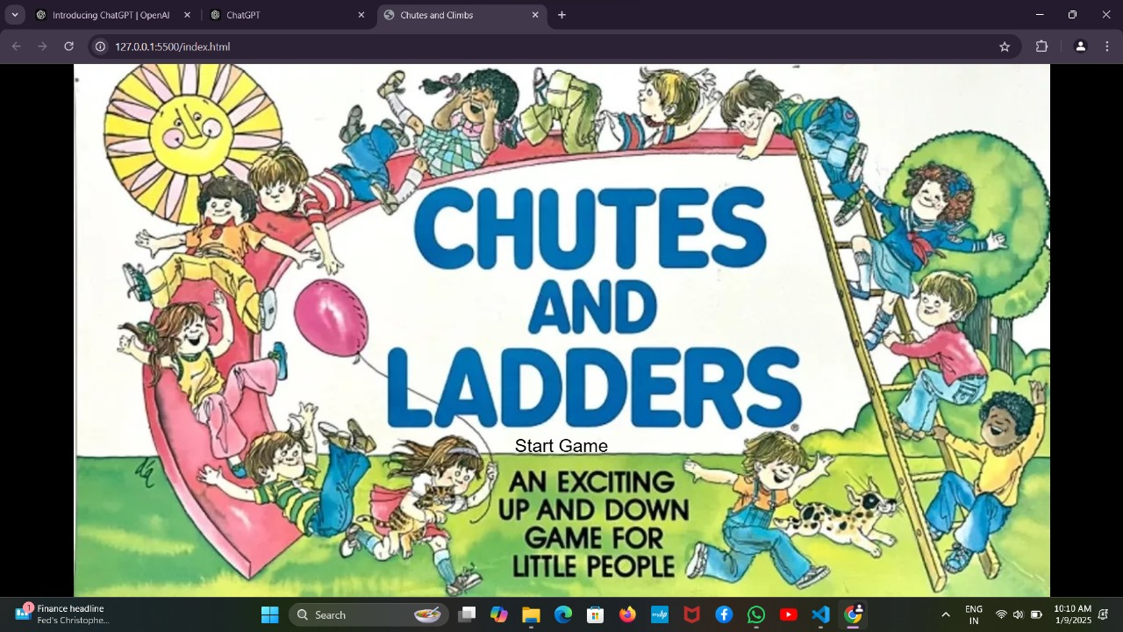
Result(Output Screens) :

Slide 19
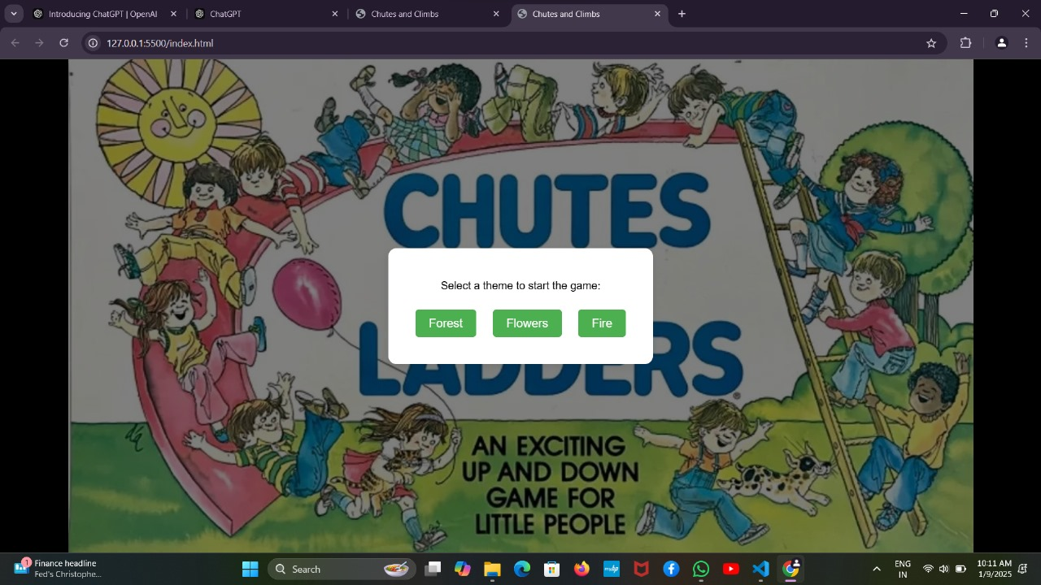

Slide 20
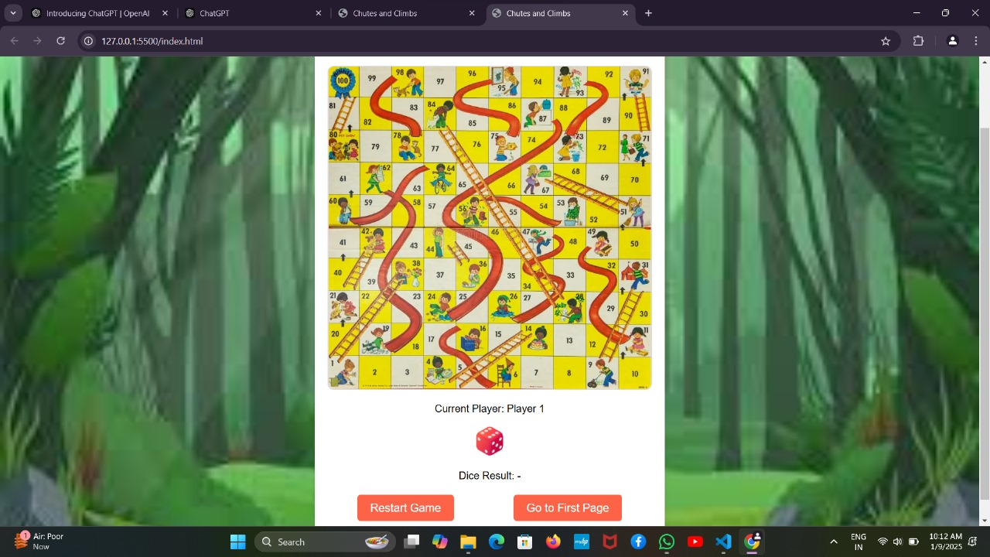

Slide 21
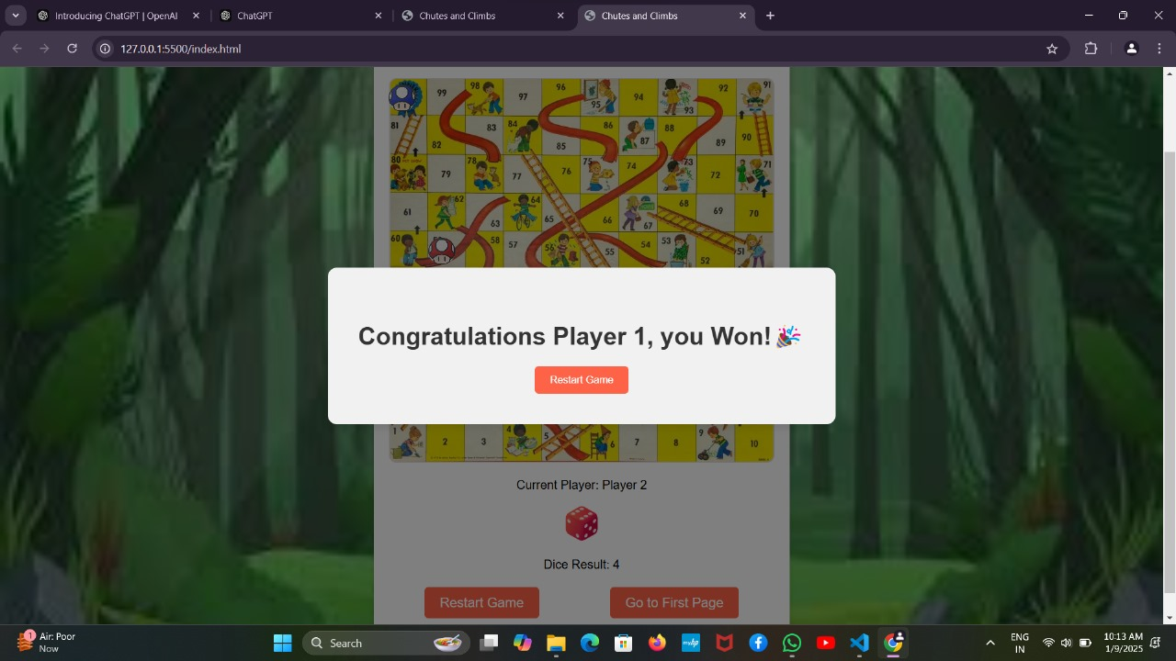

Slide 22

Conclusion :
In conclusion, the Chutes and Ladders game successfully demonstrates fundamental programming concepts and user interaction design. The project not only reinforces critical thinking and problem- solving skills but also serves as a foundation for more complex game development endeavors.
Overall, this project has been an invaluable learning opportunity, showcasing the potential of simple game designs in fostering creativity and collaboration.

Slide 23
Future Scope :
Mobile App Development: Create a digital version of the game for smartphones and tablets, making it accessible to a wider audience.
AI Integration: Introduce AI-powered opponents for single-player modes and adaptive difficulty settings.
AR Integration: Develop an augmented reality version where players use their devices to see the board and interact with elements in real-world environments.
VR Experience: Create a virtual reality experience where players feel immersed in the game's world, climbing ladders and sliding down chutes.

Slide 24
References :
https://en.m.wikipedia.org/wiki/Snakes_and_ladders?utm_source=chatgpt.com#cite_ref-1
https://en.m.wikipedia.org/wiki/David_Pritchard_(chess_player)
https://toytales.ca/chutes-ladders-milton-bradley-1943/
https://youtu.be/EnEbejRgI_0

Slide 25


